Slide 1



2023-2024
Mini Project
6th Semester
3rd year
Prepared by group 1

Slide 2

Team Members
Ritik Malviya
AM21007
Leader
Ankush Gupta
Sohail Ansari
Ruchita Kumbhare
AM21062
AM22D004
AM21002
Member
Member
Member

Slide 3


PROBLEM STATEMENT

Slide 4

STUDENT PERFORMANCE ANALYSIS FOR COLLEGE

Slide 5
BRIEF INTRODUCTION
ON
pROJECT TOPIC

Slide 6

Introduction
The educational landscape is undergoing rapid changes, necessitating innovative approaches for effective outcomes
This mini project is to design and implement a system
The focus is on comprehensive analysis and prediction of college student performance

Slide 7

PROJECT HIGHLIGHTS
Platform for Students and teachers
Student Dashboard
Performance analyser
CGPA & SGPA calculator
ESE guidance

Slide 8

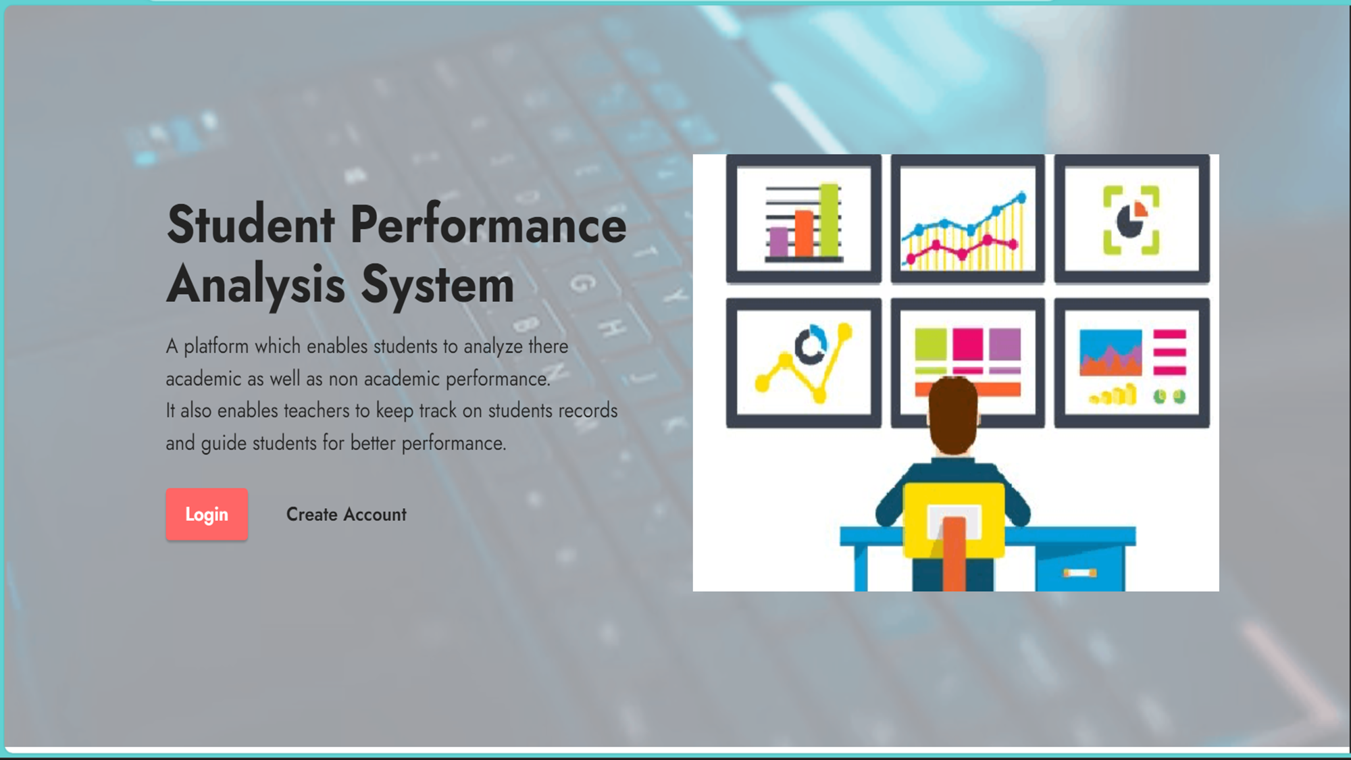

Slide 9
OBJECTIVES

Slide 10
Project Objectives
Data Collection
Model Development
Dashboard Creation
Gather relevant data including academic records, attendance, extracurricular activities, and socio-economic factors.
Identify and extract meaningful features from the collected data to build a robust performance analysis model.
Employ AIML algorithms to develop a predictive model for student performance.
Seek input from students and faculty to refine predictions and recommendations.
Develop an intuitive dashboard for visualizing and interpreting the performance analysis results.
Ensure user-friendly interfaces for administrators, faculty, and students.

Slide 11

METHODOLOGY

Slide 12
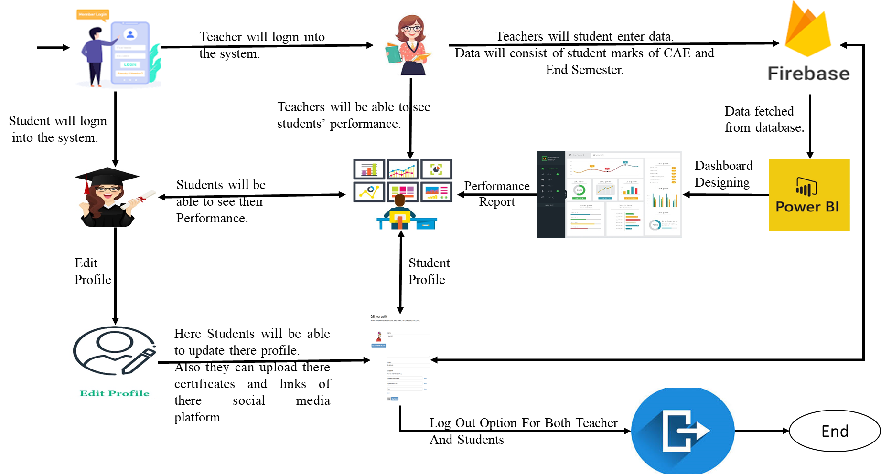
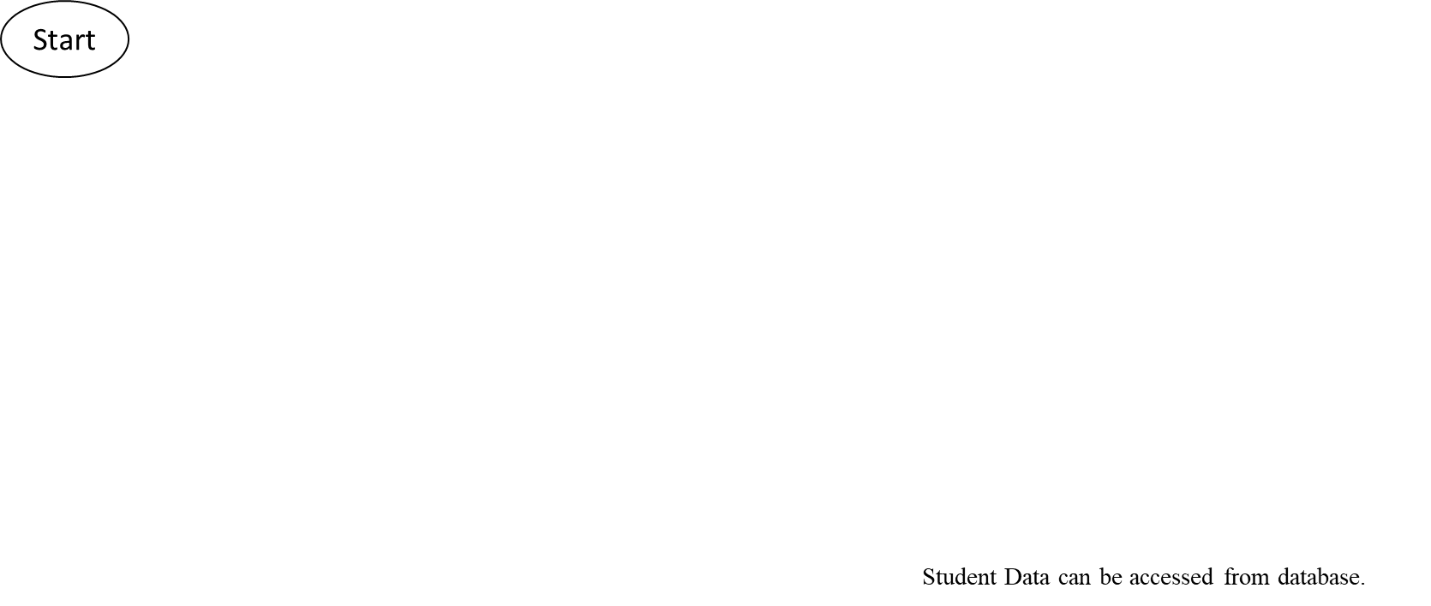
Methodology

Slide 13
EXPECTED OUTCOMES

Slide 14
Expected Outcomes
Integrate timely interventions and support mechanisms to enhance student success rates.
This mini project offers an opportunity to apply theoretical knowledge to real-world scenarios, contributing to the advancement of education through intelligent data-driven insights.
Aim for a model that can be generalized to different educational institutions.

Slide 15
Anticipated Challenges

Slide 16
Anticipated Challenges
Privacy and Security Concerns
Scalability Issues
User Adoption and Engagement
Safeguarding sensitive student data and ensuring compliance with privacy regulations
Handling an increasing number of users and data as the platform gains popularity
Encouraging students to actively use the platform and engage with the performance analytics features
Data Integration and Compatibility
Technical Maintenance and Upgrades
Educational Institution Collaboration
Integrating diverse data sources and ensuring compatibility with various educational platforms
Managing and maintaining the technical infrastructure, including regular updates and system upgrades
Collaborating with educational institutions to integrate the platform into their systems and workflows

Slide 17
RELATED RESEARCH PAPERS

Slide 18
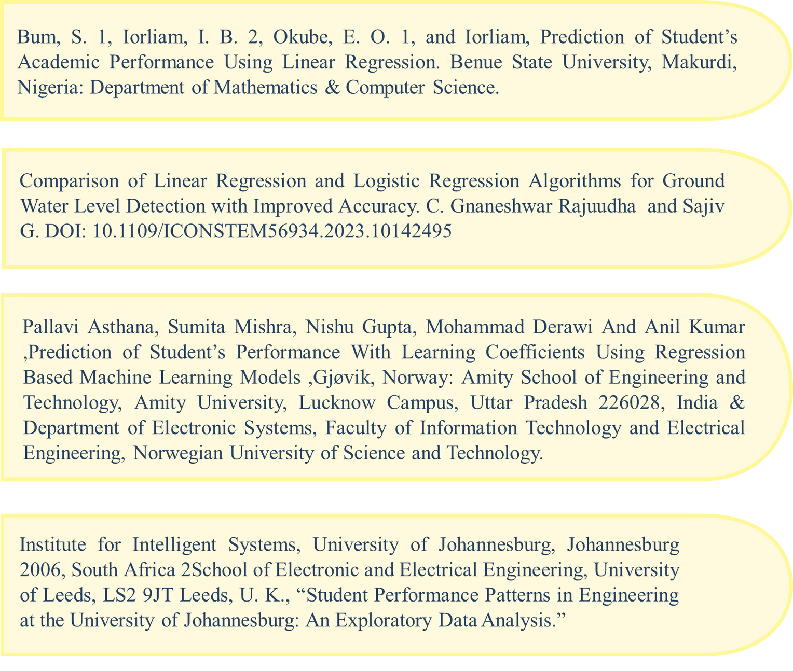


Related
Research
Papers

Slide 19


Thank You

